Slide 1
Kinetic-scale solar wind current sheets
“ The dinosaurs became extinct because they didn’t have a space programme. ”
- Larry Niven
Statistical characteristics and their role in energetic particle transport
Graduate Student: Zijin Zhang
Supervisor: Vassilis Angelopoulos
Committee: Marco Velli, Hao Cao, Paulo Alves, Anton Artemyev

Slide 2
Part 0: Research Context and Background
Part 0: Research Context and Background
Part 1: Observational Analysis of Current Sheets
Part 2: Quantitative Modeling of Particle Scattering
Part 1.5: Multifluid Model for Current Sheet Alfvénicity
Part 0.5: Software Development
Part 3: Proposed Research
Conclusion
“ You don’t have to know everything. You simply need to know where to find it when necessary. ”
- John Brunner

Slide 3
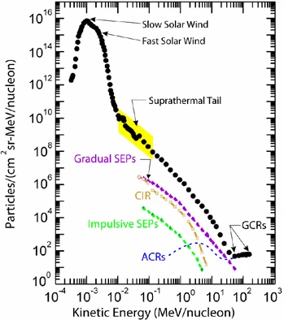
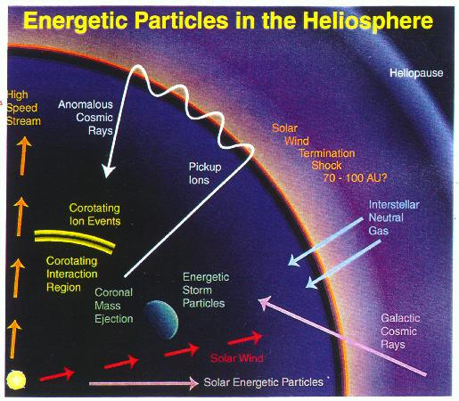

Understanding how energetic particles are transported in the heliosphere (and accelerated) remains one of the central problems in space physics & astrophysics. Despite decades of research, many long-standing questions persist.
(Parker 1965)
$$\frac{∂f}{∂t}=\frac{∂}{∂x_{i}}\left[κ_{ij}\frac{∂f}{∂x_{j}}\right]−U_{i}\frac{∂f}{∂x_{i}}−V_{d,i}\frac{∂f}{∂x_{i}}+\frac{1}{3}\frac{∂U_{i}}{∂x_{i}}\left[\frac{∂f}{∂lnp}\right]+Q$$
Four main transport processes:
spatial diffusion, advection, drifts, energy change
Desai and Giacalone (2016)
It captures four main transport processes:
spatial diffusion (particle scattering)
advection with the solar wind
drifts (such as gradient and curvature drifts)
adiabatic energy change
However, these frameworks struggle to explain all the dynamics observed.

Slide 4
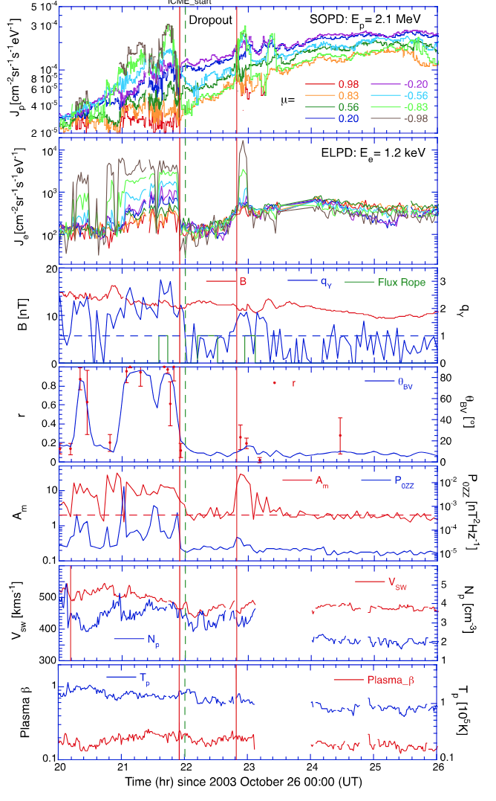
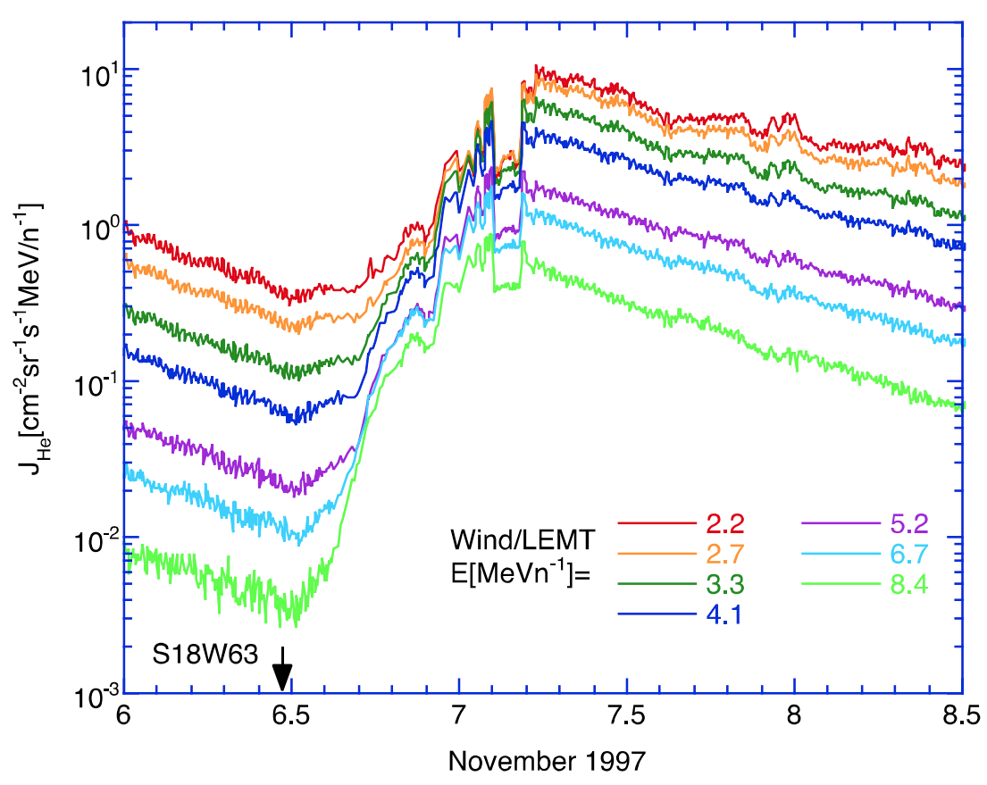
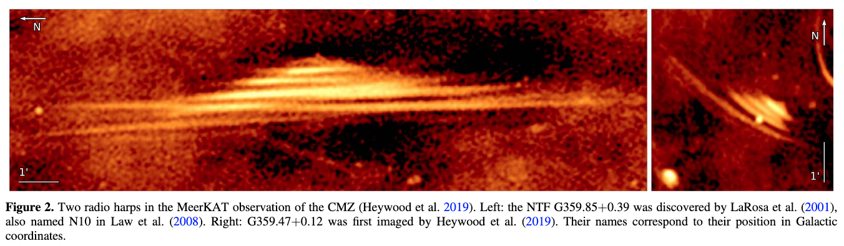

Dropouts
Time profiles of low-energy He ion intensities.
A dropout in ion intensity lasting about 2 hr (Tan 2023)
$$θ_{BV}∼0°$$
Notes:
Time profiles of lowenergy He ion intensities recorded by the Wind/LEMT sensor showing a gradual SEP event beginning on 1997 November 6. A dropout in ion intensity lasting about 2 hr can be seen during the decay phase of the gradual event. [@tanTurbulentOriginsParticle2023]

Slide 5
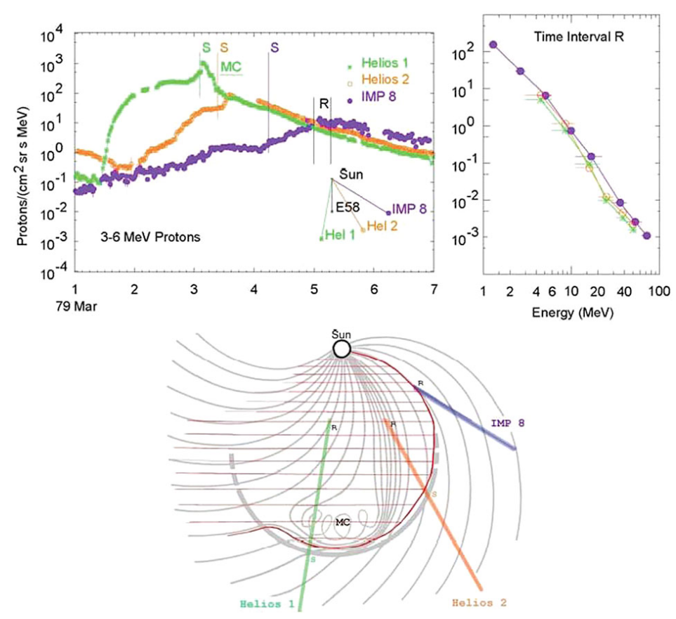

Reservoir
The intensities and energy spectra throughout much of the inner heliosphere at different azimuthal, radial, and latitudinal locations are nearly identical
=> Effective cross-field and non-diffusive transport (Lario 2010)
Intensity-time profiles for protons in the 1979 March 1 event
at 3 spacecraft
(Reames 2013)
Anomalous transport and non-Markovian phenomena
$\left\langle Δx^{2}\left(t\right)\right\rangle ∝t^{α}$ Perri and Zimbardo (2007)
Notes:
Intensity-time profiles for protons in the 1979 March 1 event at 3 spacecraft are shown in the upper left panel with times of shock passage indicated by S for each. Energy spectra in the “reservoir” at time R are shown in the upper right panel while the paths of the spacecraft through a sketch of the CME are shown below [@reamesTwoSourcesSolar2013

Slide 6
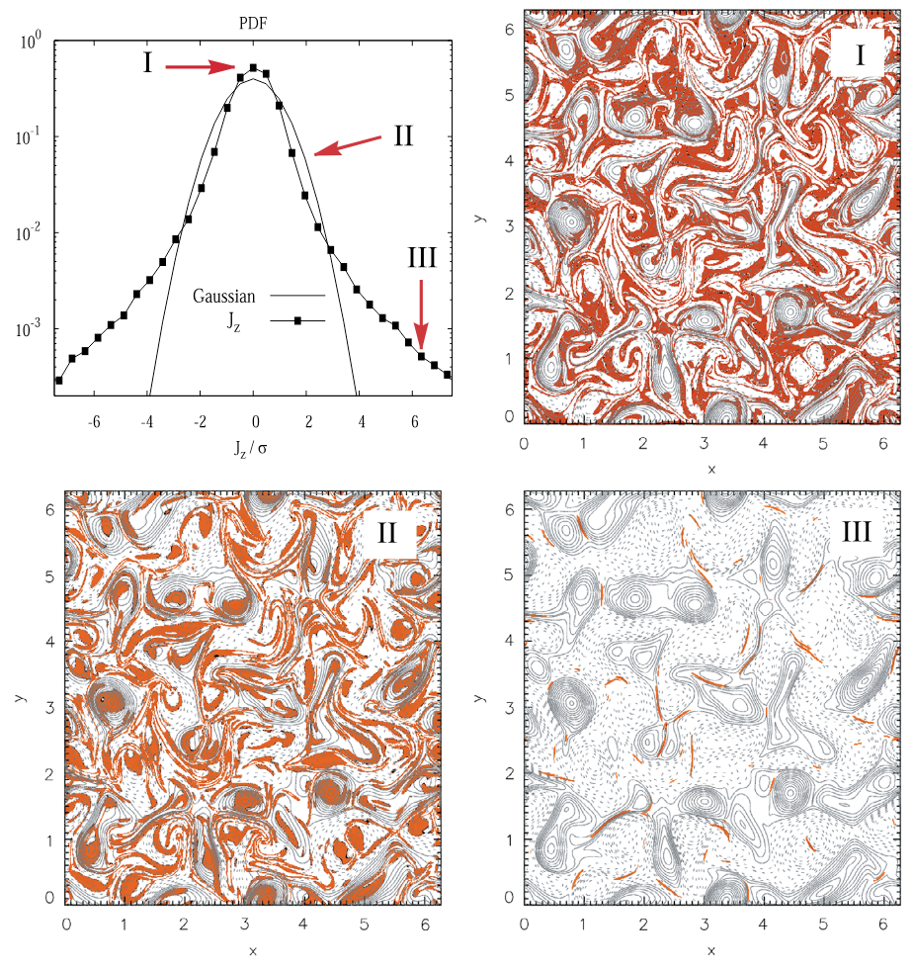
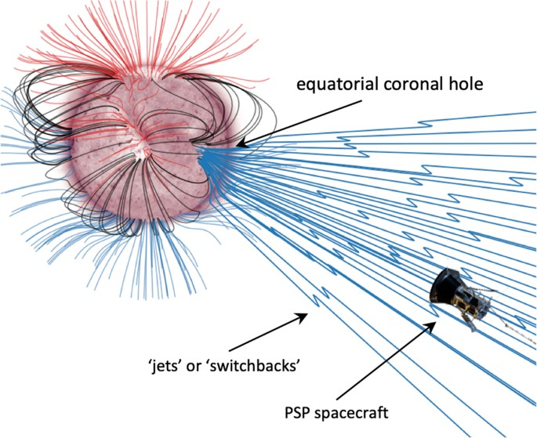

Turbulent Magnetic Fluctuations
(Greco et al. 2017)
Nonlinear energy cascade process results in the formation of coherent structures: current sheets, rotational discontinuities, tangential discontinuities, magnetic holes, switchbacks…
PDF of the out-of-plane electric current density $J_{z}$
Notes:
For each region I, II, and III, magnetic field lines (contours of constant magnetic potential $A_{z}$: > 0 solid, < 0 dashed) are shown; the colored (red) regions are places where the selected band (I, II, or III) contributes. (Greco et al. 2017)
A physically appealing interpretation emerges: region I consists of very low values of fluctuations that lie mainly in the lanes between magnetic islands. Region II consists of sub-Gaussian current cores that populate the central regions of the magnetic islands (or flux tubes). Region III is composed of the coherent small-scale current sheet-like structures that form the sharp boundaries between the magnetic flux tubes. This classification provides a real-space picture of the nature of intermittent MHD turbulence.

Slide 7
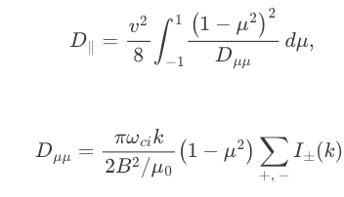
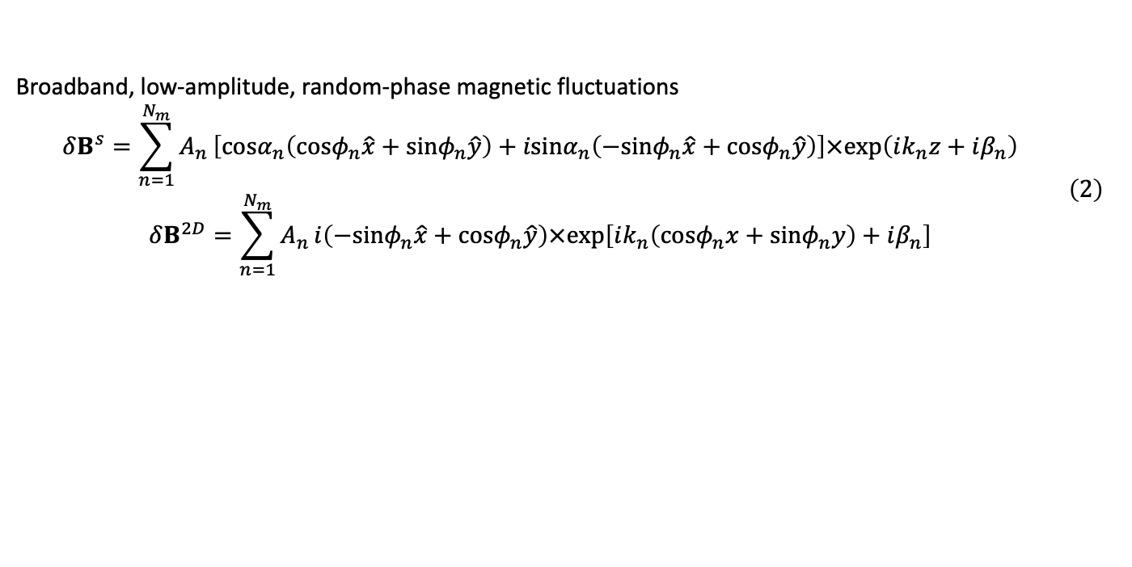
Turbulence Transport Models (TTMs)
Broadband, low-amplitude, random-phase magnetic fluctuations
$$\begin{matrix} & δB^{s}=\sum_{n=1}^{N_{m}}{A_{n}}\left[cosα_{n}\left(cosφ_{n}\hat{x}+sinφ_{n}\hat{y}\right)+isinα_{n}\left(−sinφ_{n}\hat{x}+cosφ_{n}\hat{y}\right)\right]×exp\left(ik_{n}z+iβ_{n}\right) \\ & δB^{2D}=\sum_{n=1}^{N_{m}}{A_{n}}i\left(−sinφ_{n}\hat{x}+cosφ_{n}\hat{y}\right)×exp\left[ik_{n}\left(cosφ_{n}x+sinφ_{n}y\right)+iβ_{n}\right]\end{matrix} \left(2\right)$$
Quasilinear theory
Wavelet-based synthetic turbulence model (Juneja et al. 1994) similar to p-model (Meneveau and Sreenivasan 1987).
Notes:
Pucci et al. (2016) studied the influence of spectral extension and intermittency on particle transport.

Slide 8
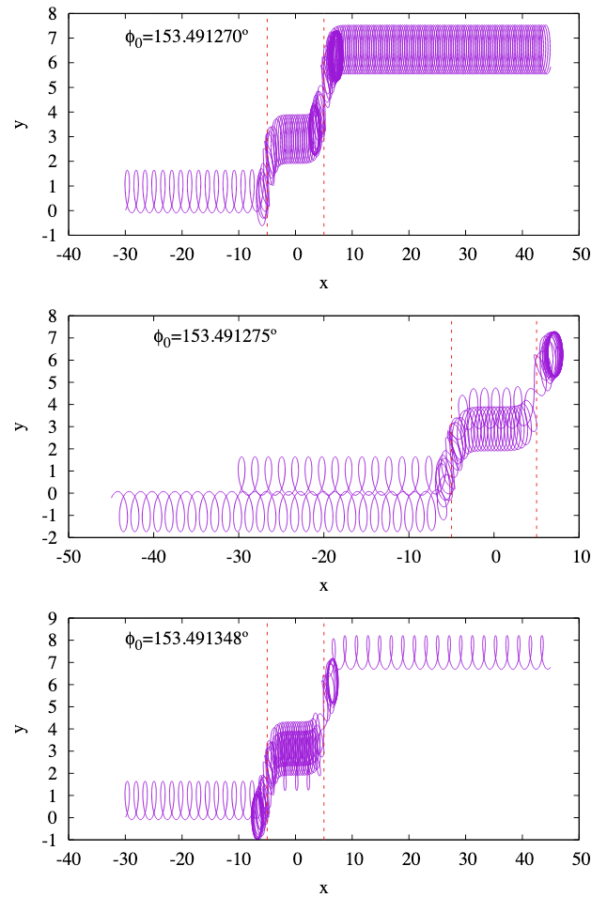
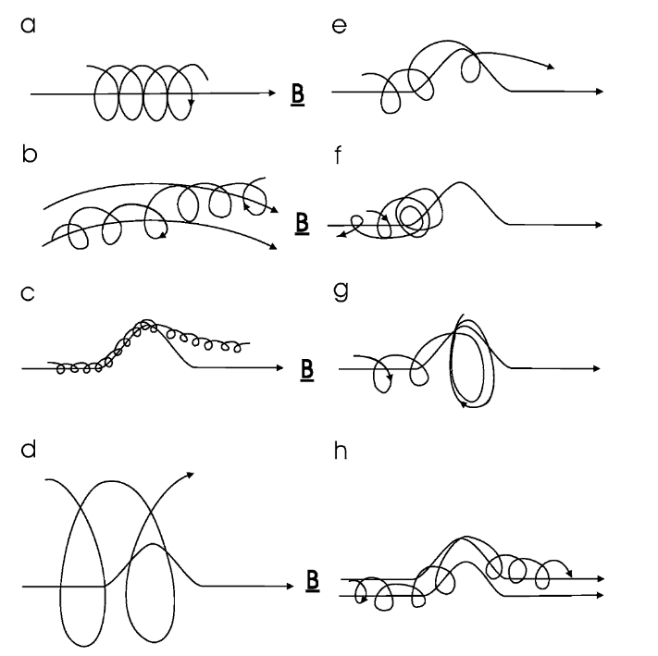
The Role of Current Sheets in Particle Transport
Moraal (2013)
Malara et al.
(2023)
Trajectories of three particles of 1 MeV SEP interaction with switchback
Notes:
Fig. 1 Charged particle motion in a magnetic field. (a) In a uniform magnetic field the particle has a spiral orbit with a gyroradius rg = P /Bc. (b) When the field is non-uniform the particle drifts away from a field line due to the gradient and curvature of the field. (c) When a particle meets a kink in the field that has a scale length rg , all particles will progress through the kink (but they may drift to adjacent field lines while doing so). (d) Likewise, if rg scale size of the kink, all particles will pass through it without being affected much. (e, f, g) When rg ≈ scale size of the kink, it depends on the gyrophase of the motion when the particles starts to feel the kink whether it will go through the kink (e), be reflected back (f), or effectively get stuck in the kink (g). This process is called pitch-angle scattering along the field. (h) When particles meet such a kink, there is also a scattering in phase angle, which leads to scattering across the field lines, but such that κ⊥ κ‖

Slide 9
Main Scientific Objective
Motivation / Gap : No prior studies systematically characterize particle interactions with solar wind current sheets
Quantitative understanding of how these structures influence energetic particles transport
Observational characterization of solar wind current sheets across the heliosphere
Development of data-driven theoretical models for current sheet-induced particle scattering and transport

Slide 10
Part 1: Observational Analysis of Current Sheets
Part 0: Research Context and Background
Part 1: Observational Analysis of Current Sheets
Part 2: Quantitative Modeling of Particle Scattering
Part 1.5: Multifluid Model for Current Sheet Alfvénicity
Part 0.5: Software Development
Part 3: Proposed Research
Conclusion
“ Wanderer, there is no path the path is forged as you wander. ”
- Antonio Machado

Slide 11
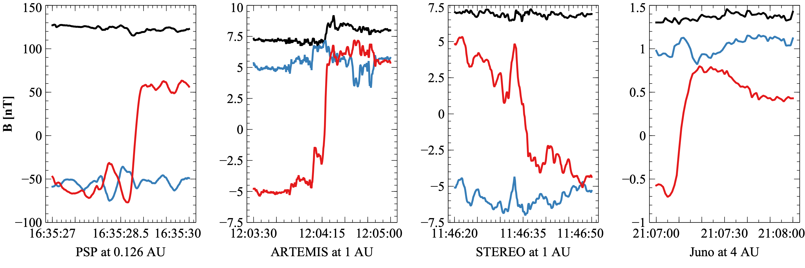
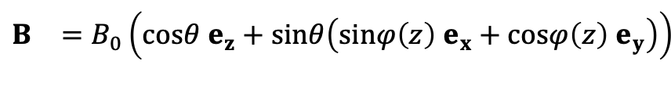
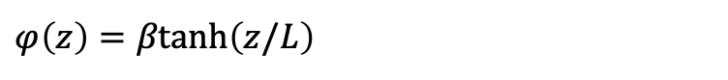
What are the properties of current sheets that are most relevant to particle transport?
Similar to the role of turbulence level, spectral index, anisotropy and intermittency in turbulence transport models?
As a first-order approximation, we use a simple magnetic field configuration
Current sheets detected by PSP, Juno, STEREO and near-Earth ARTEMIS satellite
$$\begin{matrix}B & =B_{0}\left(cosθ e_{z}+sinθ\left(sinφ\left(z\right) e_{x}+cosφ\left(z\right) e_{y}\right)\right) \\ & \end{matrix}$$
$φ\left(z\right)=βtanh\left(z/L\right)$

Slide 12

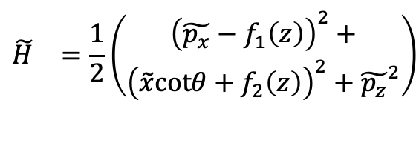
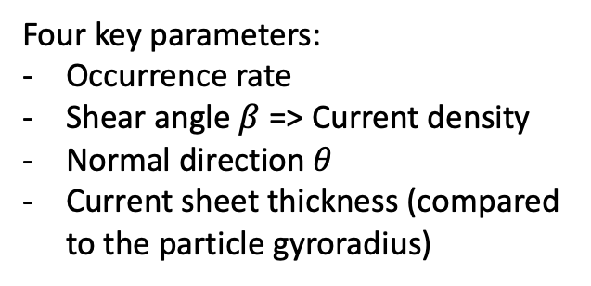
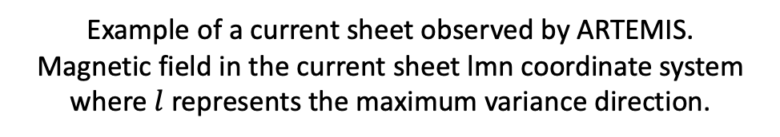
Hamiltonian formalism
The motion of particle after
simplification and normalization:
$$\begin{matrix}\tilde{H} & =\frac{1}{2}\left(\begin{aligned}{\left(\tilde{p_{x}}−f_{1}\left(z\right)\right)}^{2}+ \\ {\left(\tilde{x}cotθ+f_{2}\left(z\right)\right)}^{2}+{\tilde{p_{z}}}^{2}\end{aligned}\right) \\ & \\ & \end{matrix}$$
Four key parameters:
Occurrence rate
Shear angle $β$ => Current density
Normal direction $θ$
Current sheet thickness (compared to the particle gyroradius)
Example of a current sheet observed by ARTEMIS.
Magnetic field in the current sheet $\text{lmn}$ coordinate system where $l$ represents the maximum variance direction.
$$J_{m}=−\frac{1}{μ_{0}V_{n}}\frac{dB_{l}}{dt}$$
Notes:
($B_{x}=B_{t}sinφ$ in our model), $m$ the intermediate variance direction ($B_{y}=B_{t}cosφ$), and $n$ the minimum variance direction ($B_{z}=B_{0}cosθ$). Here, $B_{t}$ and $B_{0}$ represent the tangential and total magnetic fields, respectively. Bottom: variations of the azimuthal angle $φ$ and the azimuthal angle $θ$ across the current sheet. Vertical lines indicate the current sheet boundaries, and the horizontal line represents $π/2$

Slide 13
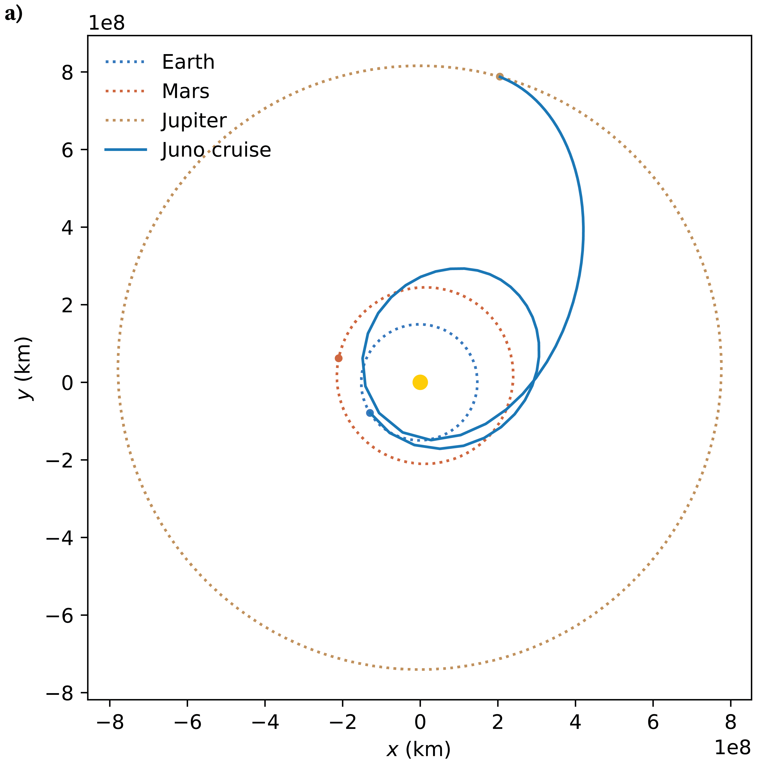
What do we know about these parameters across the heliosphere?
Past studies often
lacked simultaneous multi-point measurements,
employed different identification and quantification methods, and
did not sufficiently separate temporal variability from spatial trends
Leading to significant uncertainties.
From inner heliosphere (Parker Solar Probe, PSP) to 1 AU (ARTEMIS, Wind) to outer heliosphere (Juno).

Slide 14
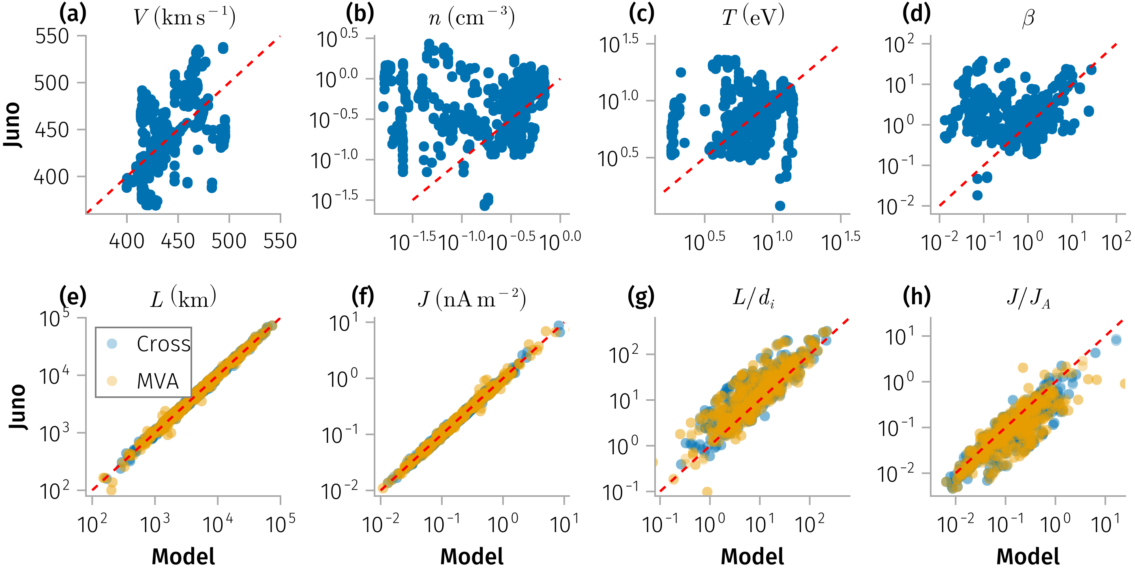
Dataset and Methods
Comparison of solar wind properties (top) and
discontinuity properties (bottom) between / using
model (x-axis) and JADE observations.
Notes:
). (a-d) Solar wind velocity, density, temperature, and plasma beta. (e-h) Discontinuity thickness, current density, normalized thickness, and normalized current density. Blue dots indicate values derived using the cross-product normal method, while yellow dots

Slide 15
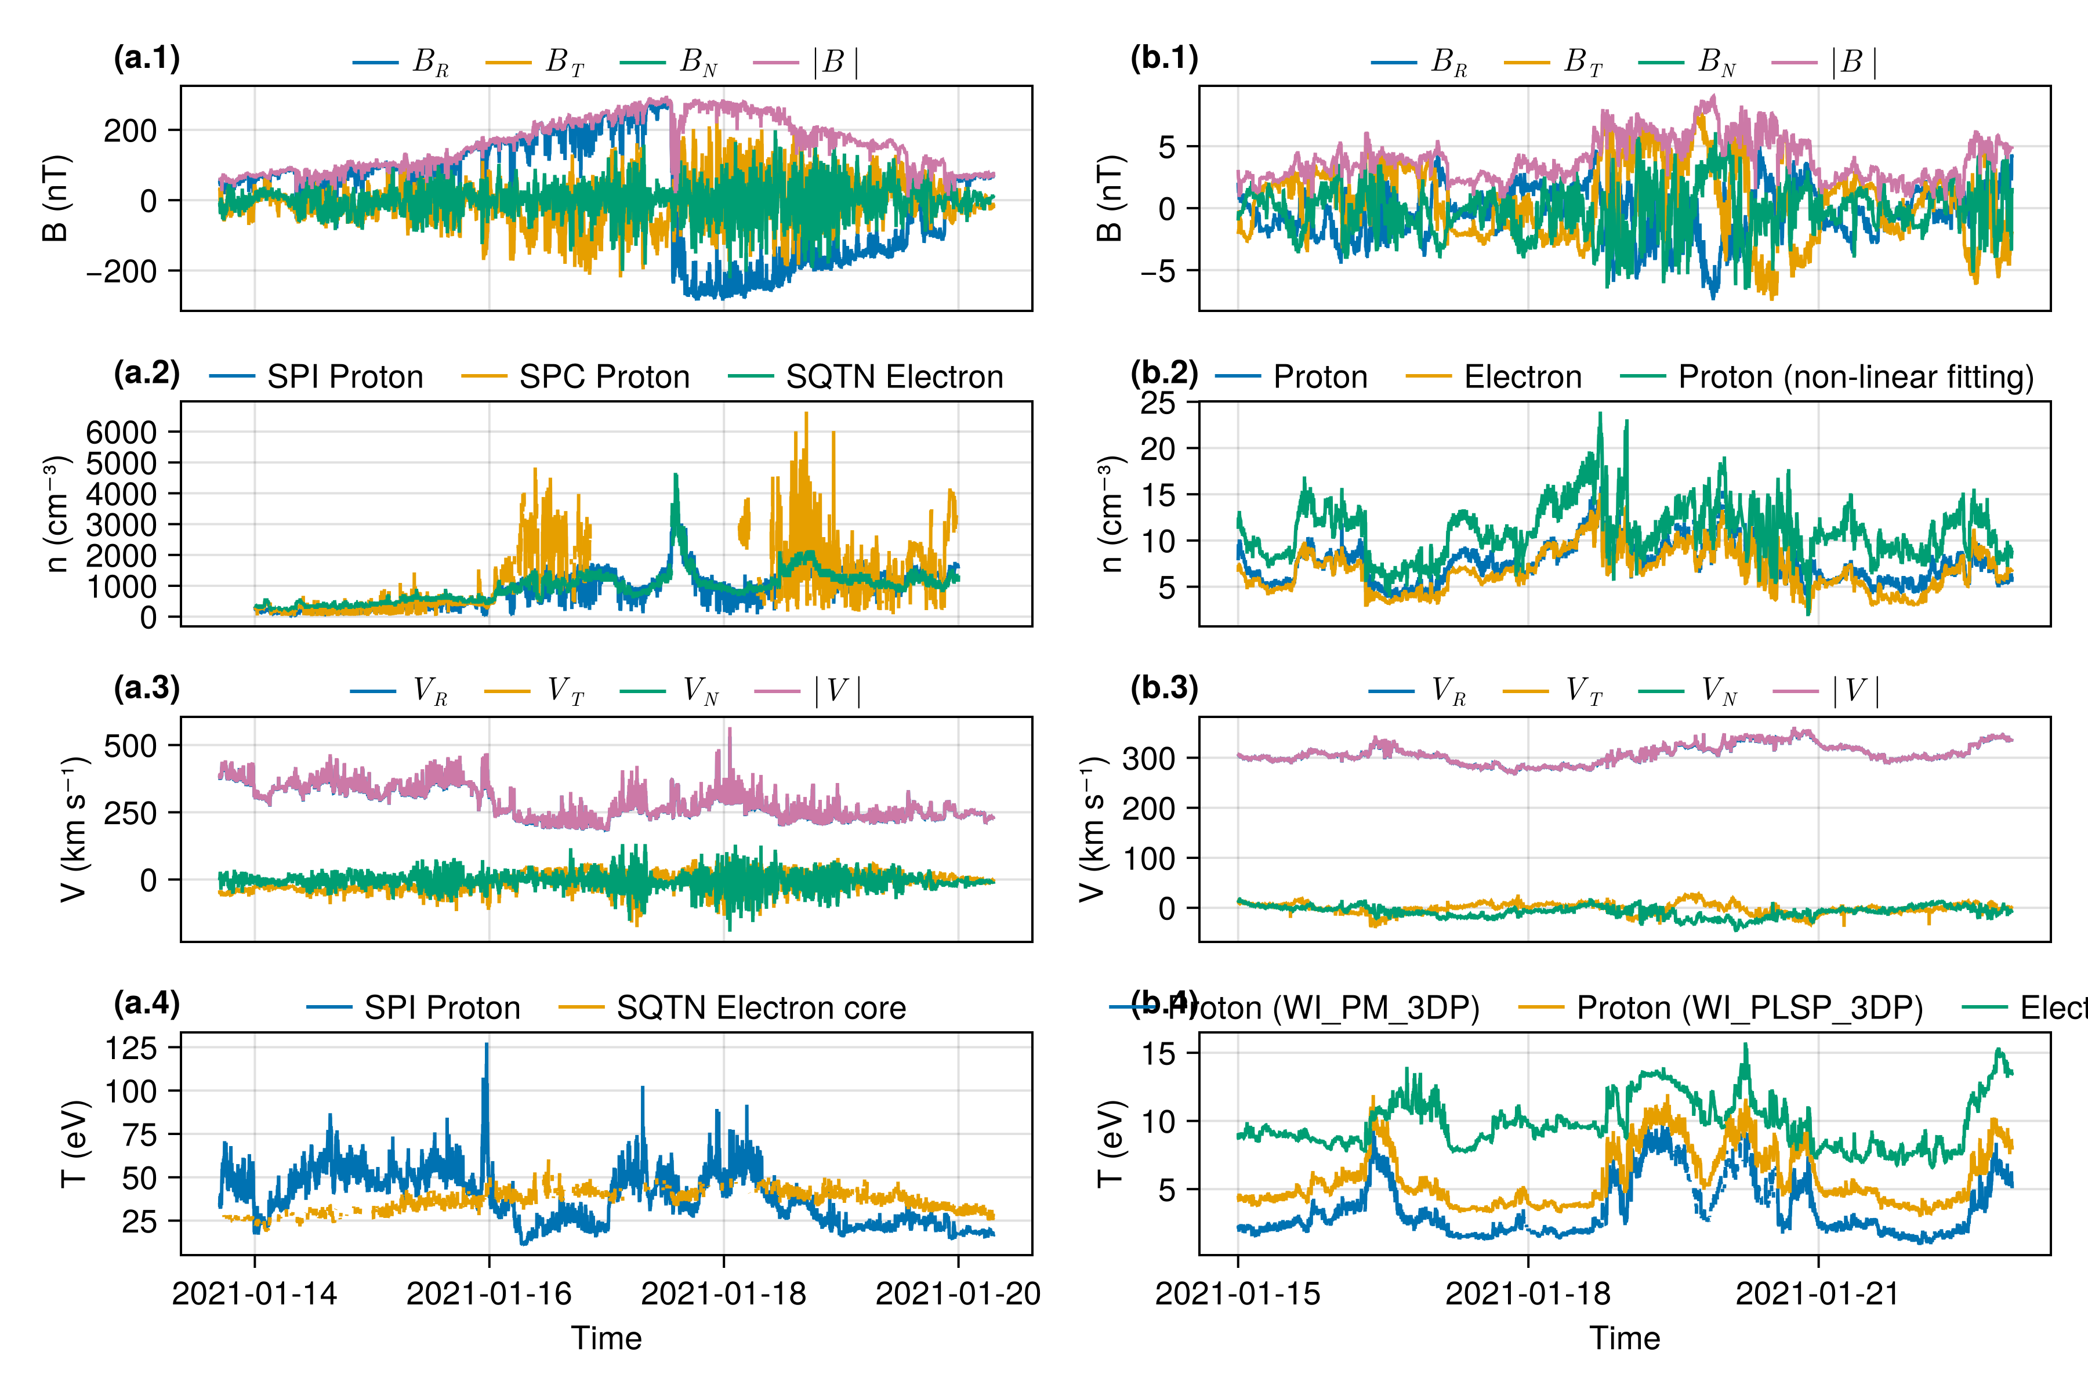
Dataset and Methods
Overview of solar wind properties during encounter 8 (when PSP is aligned with Earth observations)

Slide 16
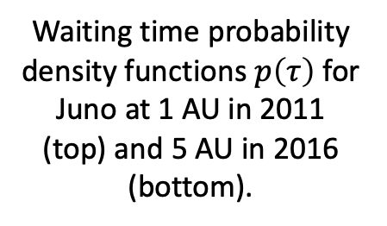
Discontinuity properties: occurrence rate
Waiting time probability density functions $p\left(τ\right)$ for Juno at 1 AU in 2011 (top) and 5 AU in 2016 (bottom).
Notes:
Observed data (black) are fitted with Weibull (blue) and exponential (orange) distributions. Vertical dashed lines denote the mean waiting times for each fitted distribution.

Slide 17
Discontinuity properties: occurrence rate
Left: the occurrence rate of discontinuities measured by Juno, STEREO-A, THEMIS-B, and Wind.
Right: the normalized occurrence rate as a function of radial distance.

Slide 18
Discontinuity properties: current density and thickness
Figure: Distribution of various SWD properties observed by Juno, grouped by radial distance from the Sun.

Slide 19
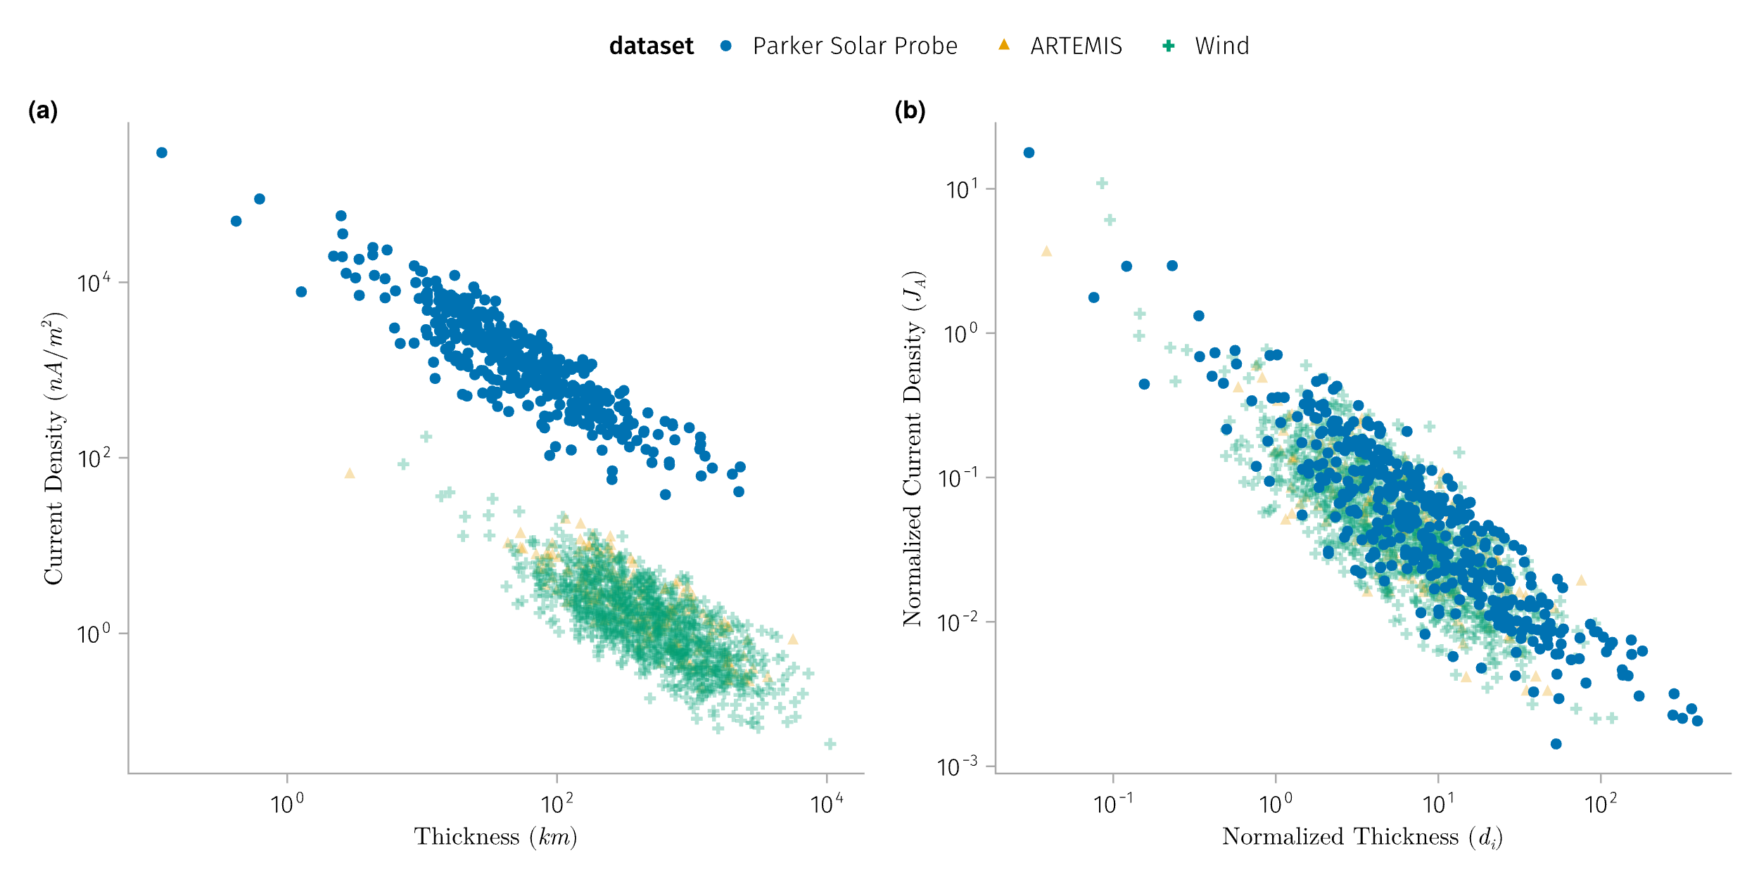
Discontinuity properties: current density and thickness

Slide 20
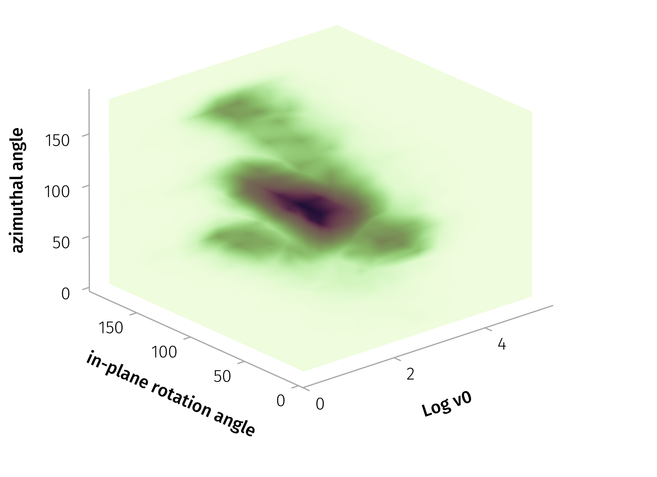
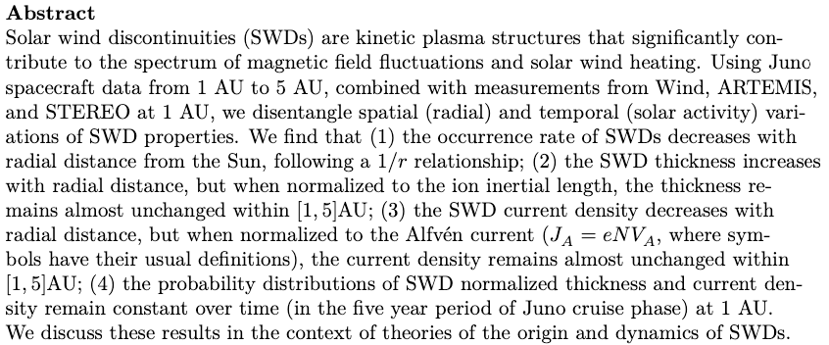
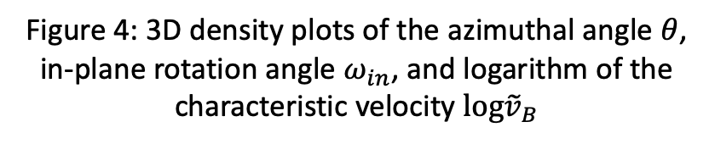
Critical empirical constraints for particle transport modeling
Solar wind current sheets maintain kinetic-scale thicknesses throughout the inner heliosphere: normalized thickness and current density remain nearly constant over the range from 0.1 to 5 AU
This work is presented in “Solar wind discontinuities in the outer heliosphere: Spatial distribution between 1 and 5 AU” (Zhang et al., JGR Space Physics, 2025).
Figure 4: 3D density plots of the azimuthal angle $θ$, in-plane rotation angle $ω_{in}$, and logarithm of the characteristic velocity $log{\tilde{v}}_{B}$

Slide 21
Part 2: Quantitative Modeling of Particle Scattering
Part 0: Research Context and Background
Part 1: Observational Analysis of Current Sheets
Part 2: Quantitative Modeling of Particle Scattering
Part 1.5: Multifluid Model for Current Sheet Alfvénicity
Part 0.5: Software Development
Part 3: Proposed Research
Conclusion
In physics, you don’t have to go around making trouble for yourself – nature does it for you.
- Frank Wilczek

Slide 22
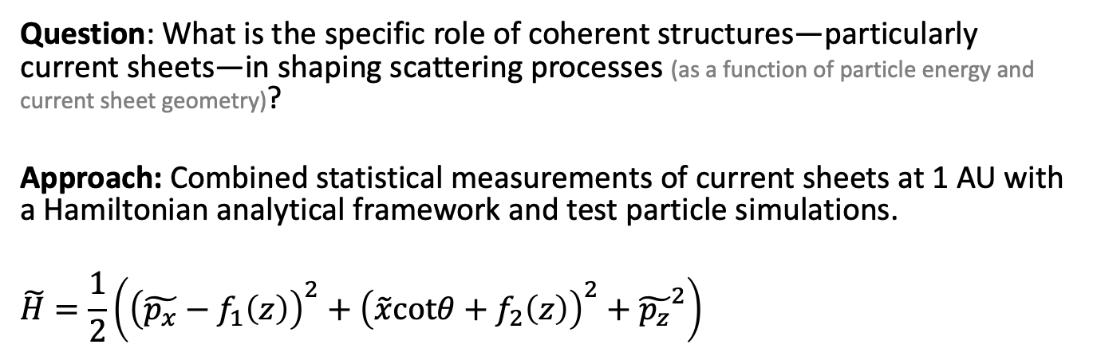

The Problem: Scattering by Current Sheets (Geometrical Chaotization)
Malara et al. (2023), Malara, Perri, and Zimbardo (2021)
Artemyev et al. (2020) , Artemyev, Neishtadt, and Zelenyi (2013a, 2013b)
Zelenyi et al. (2013), Neishtadt (2000)
Büchner and Zelenyi (1989), ), Chen (1986), Tennyson et al (1986)
Question: What is the specific role of coherent structures—particularly current sheets—in shaping scattering processes (as a function of particle energy and current sheet geometry)?
Approach: Combined statistical measurements of current sheets at 1 AU with a Hamiltonian analytical framework and test particle simulations.
$$\tilde{H}=\frac{1}{2}\left({\left(\tilde{p_{x}}−f_{1}\left(z\right)\right)}^{2}+{\left(\tilde{x}cotθ+f_{2}\left(z\right)\right)}^{2}+{\tilde{p_{z}}}^{2}\right)$$
$$κ=cotθ$$
$$f_{1}\left(z\right) \sim z−\frac{1}{6}β^{2}z^{3}+O\left(z^{4}\right)$$
$$f_{2}\left(z\right) \sim \frac{βz^{2}}{2}+O\left(z^{4}\right)$$

Slide 23
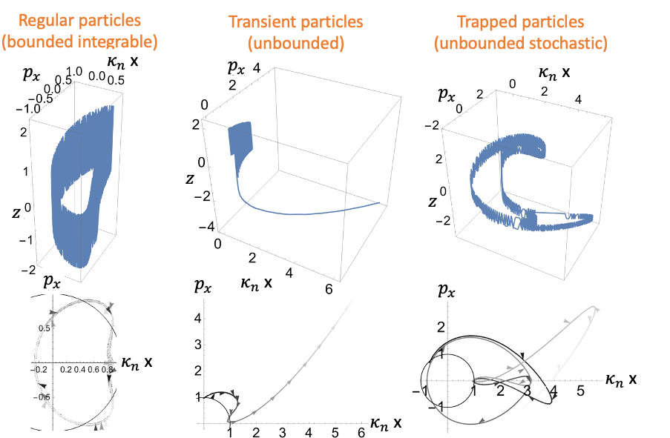
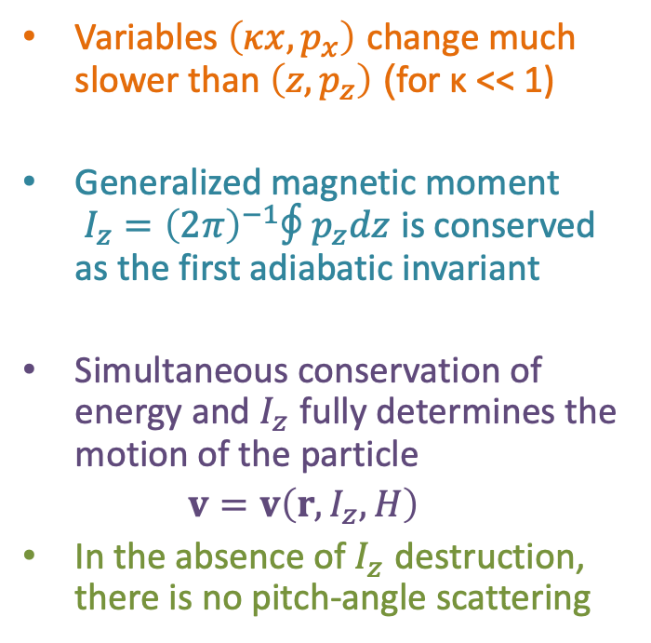
Adiabatic Invariance and Pitch Angle
Variables $\left(κx,p_{x}\right)$ change much slower than $\left(z,p_{z}\right)$ (for κ << 1)
Generalized magnetic moment $I_{z}={\left(2π\right)}^{−1}∮p_{z}dz$ is conserved as the first adiabatic invariant
Simultaneous conservation of energy and $I_{z}$ fully determines the motion of the particle
$v=v\left(r,I_{z},H\right)$
In the absence of $I_{z}$ destruction, there is no pitch-angle scattering
Particle trajectories in phase space
Notes:
Key Points:
Definition of adiabatic invariance and the magnetic moment (I_z).
Conditions under which the adiabatic invariant is conserved.
Notes:
Explain the concept of adiabatic invariance in simple terms.
Discuss why maintaining (I_z) is important for particle trajectory predictions.
Image Suggestion:
Diagram depicting adiabatic invariance with trajectories in phase space.

Slide 24
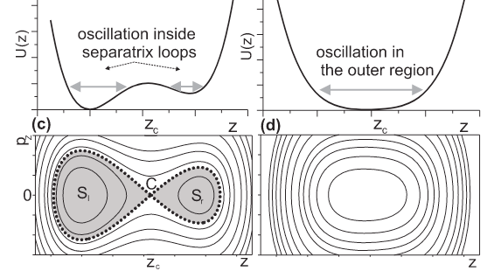
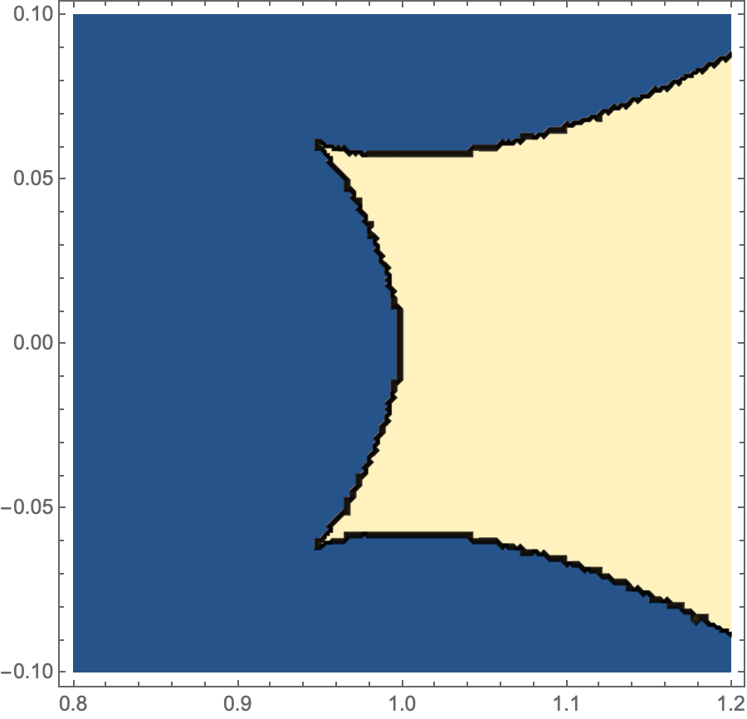
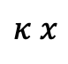
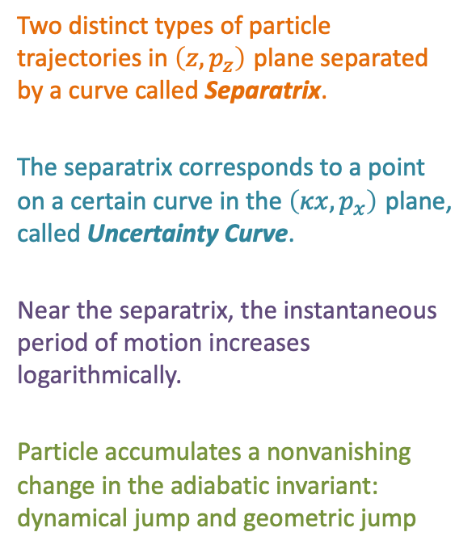
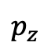
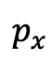
Destruction of Adiabatic Invariance: Separatrix and Uncertainty Curve
Two distinct types of particle trajectories in $\left(z,p_{z}\right)$ plane separated by a curve called Separatrix.
The separatrix corresponds to a point on a certain curve in the $\left(κx,p_{x}\right)$ plane, called Uncertainty Curve.
Near the separatrix, the instantaneous period of motion increases logarithmically.
Particle accumulates a nonvanishing change in the adiabatic invariant: dynamical jump and geometric jump
$$p_{z}$$
One solution
$$p_{x}$$
Uncertainty curve
Two solution
$$κ x$$

Slide 25
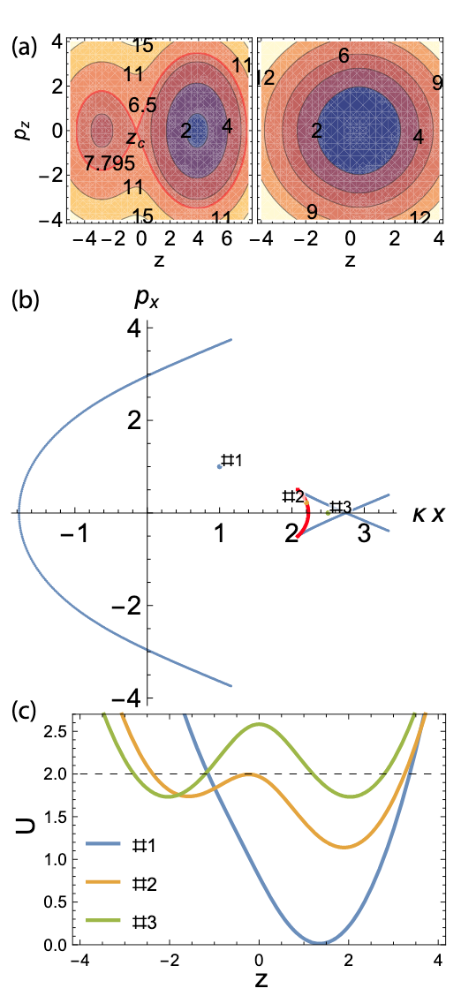

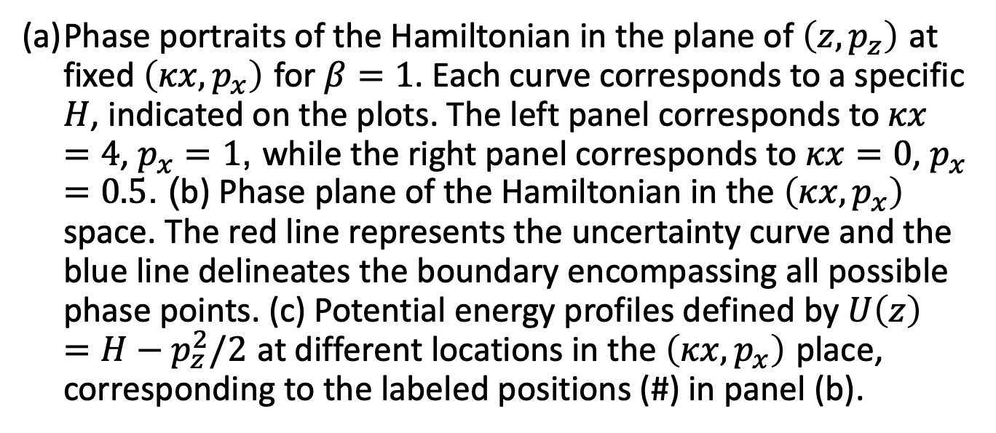
Phase portraits and Potential energy profiles
$$U\left(z\right)=H−p_{z}^{2}/2$$
Phase portraits of the Hamiltonian in the plane of $\left(z,p_{z}\right)$ at fixed $\left(κx,p_{x}\right)$ for $β=1$. Each curve corresponds to a specific $H$, indicated on the plots. The left panel corresponds to $κx=4$, $p_{x}=1$, while the right panel corresponds to $κx=0$, $p_{x}=0.5$. (b) Phase plane of the Hamiltonian in the $\left(κx,p_{x}\right)$ space. The red line represents the uncertainty curve and the blue line delineates the boundary encompassing all possible phase points. (c) Potential energy profiles defined by $U\left(z\right)=H−p_{z}^{2}/2$ at different locations in the $\left(κx,p_{x}\right)$ place, corresponding to the labeled positions (#) in panel (b).
Notes:
Phase portraits of the Hamiltonian in the plane of $\left(z,p_{z}\right)$ at fixed $\left(κx,p_{x}\right)$ for $β=1$. Each curve corresponds to a specific $H$, indicated on the plots. The left panel corresponds to $κx=4$, $p_{x}=1$, while the right panel corresponds to $κx=0$, $p_{x}=0.5$. (b) Phase plane of the Hamiltonian in the $\left(κx,p_{x}\right)$ space. The red line represents the uncertainty curve and the blue line delineates the boundary encompassing all possible phase points. (c) Potential energy profiles defined by $U\left(z\right)=H−p_{z}^{2}/2$ at different locations in the $\left(κx,p_{x}\right)$ place, corresponding to the labeled positions (#) in panel (b).

Slide 26
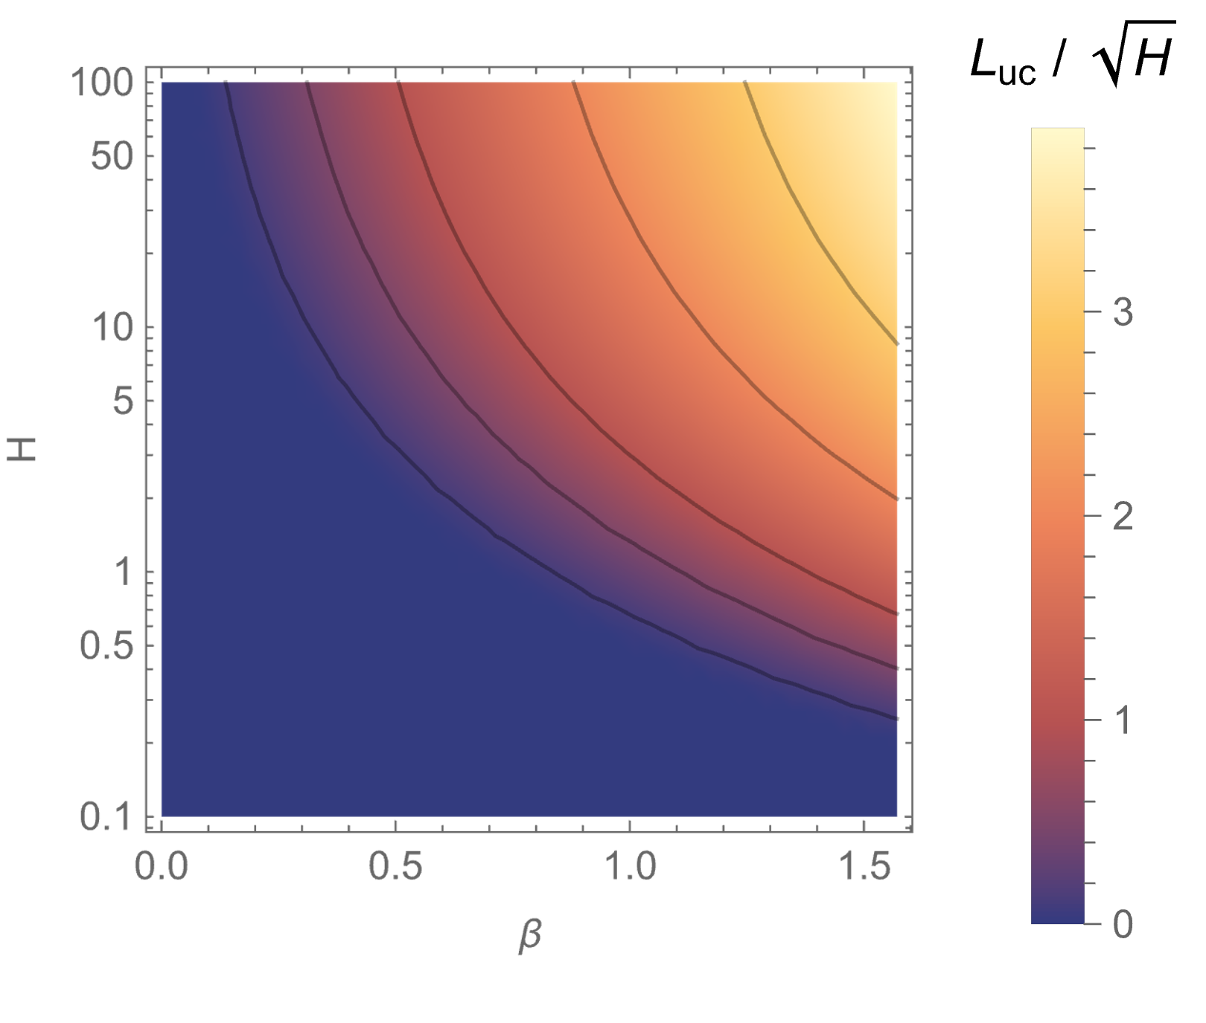
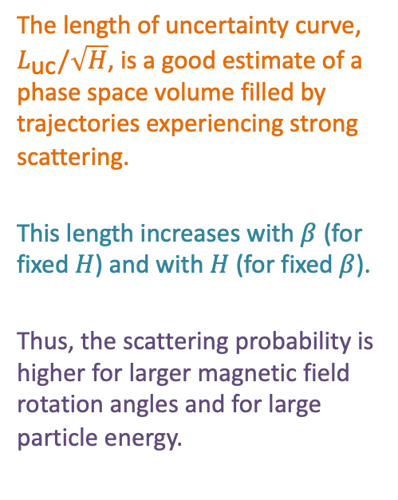
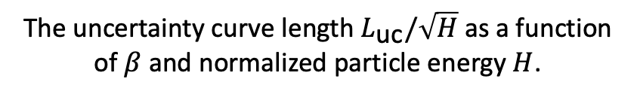
Uncertainty curve
The length of uncertainty curve, $L_{\text{uc}}/\sqrt{H}$, is a good estimate of a phase space volume filled by trajectories experiencing strong scattering.
This length increases with $β$ (for fixed $H$) and with $H$ (for fixed $β$).
Thus, the scattering probability is higher for larger magnetic field rotation angles and for large particle energy.
The uncertainty curve length $L_{\text{uc}}/\sqrt{H}$ as a function of $β$ and normalized particle energy $H$.

Slide 27
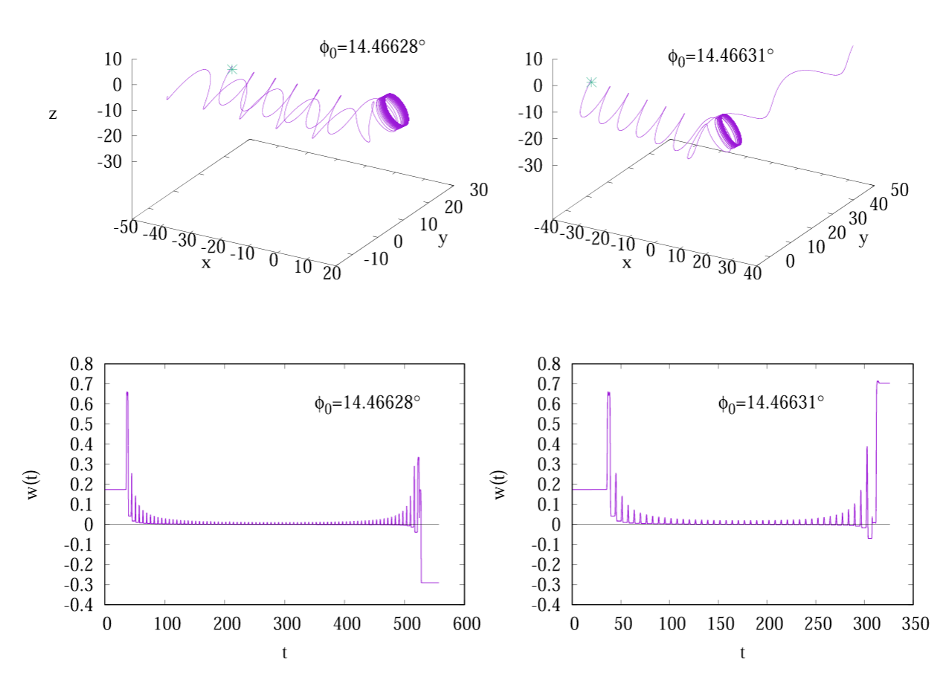
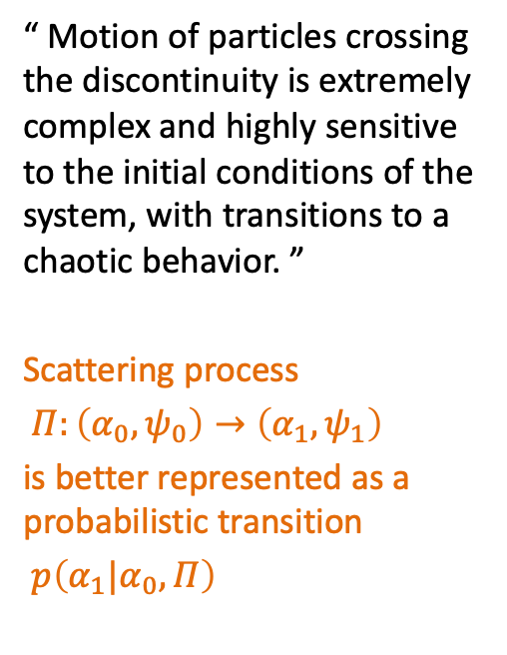

Examples of Pitch Angle Scattering
“ Motion of particles crossing the discontinuity is extremely complex and highly sensitive to the initial conditions of the system, with transitions to a chaotic behavior. ”
Scattering process
$Π:\left(α_{0},ψ_{0}\right)→\left(α_{1},ψ_{1}\right)$
is better represented as a probabilistic transition
$p\left(α_{1}|α_{0},Π\right)$
$$cos α(t)$$
The trajectories of two particles starting with two slightly different gyrophases
Malara, Perri, and Zimbardo (2021)

Slide 28
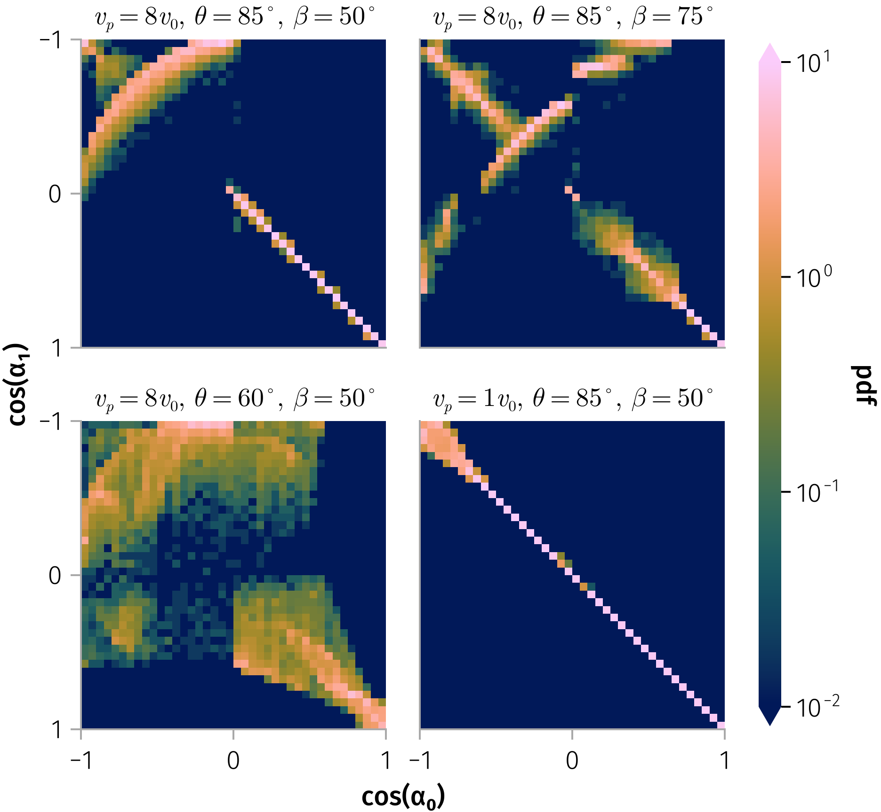
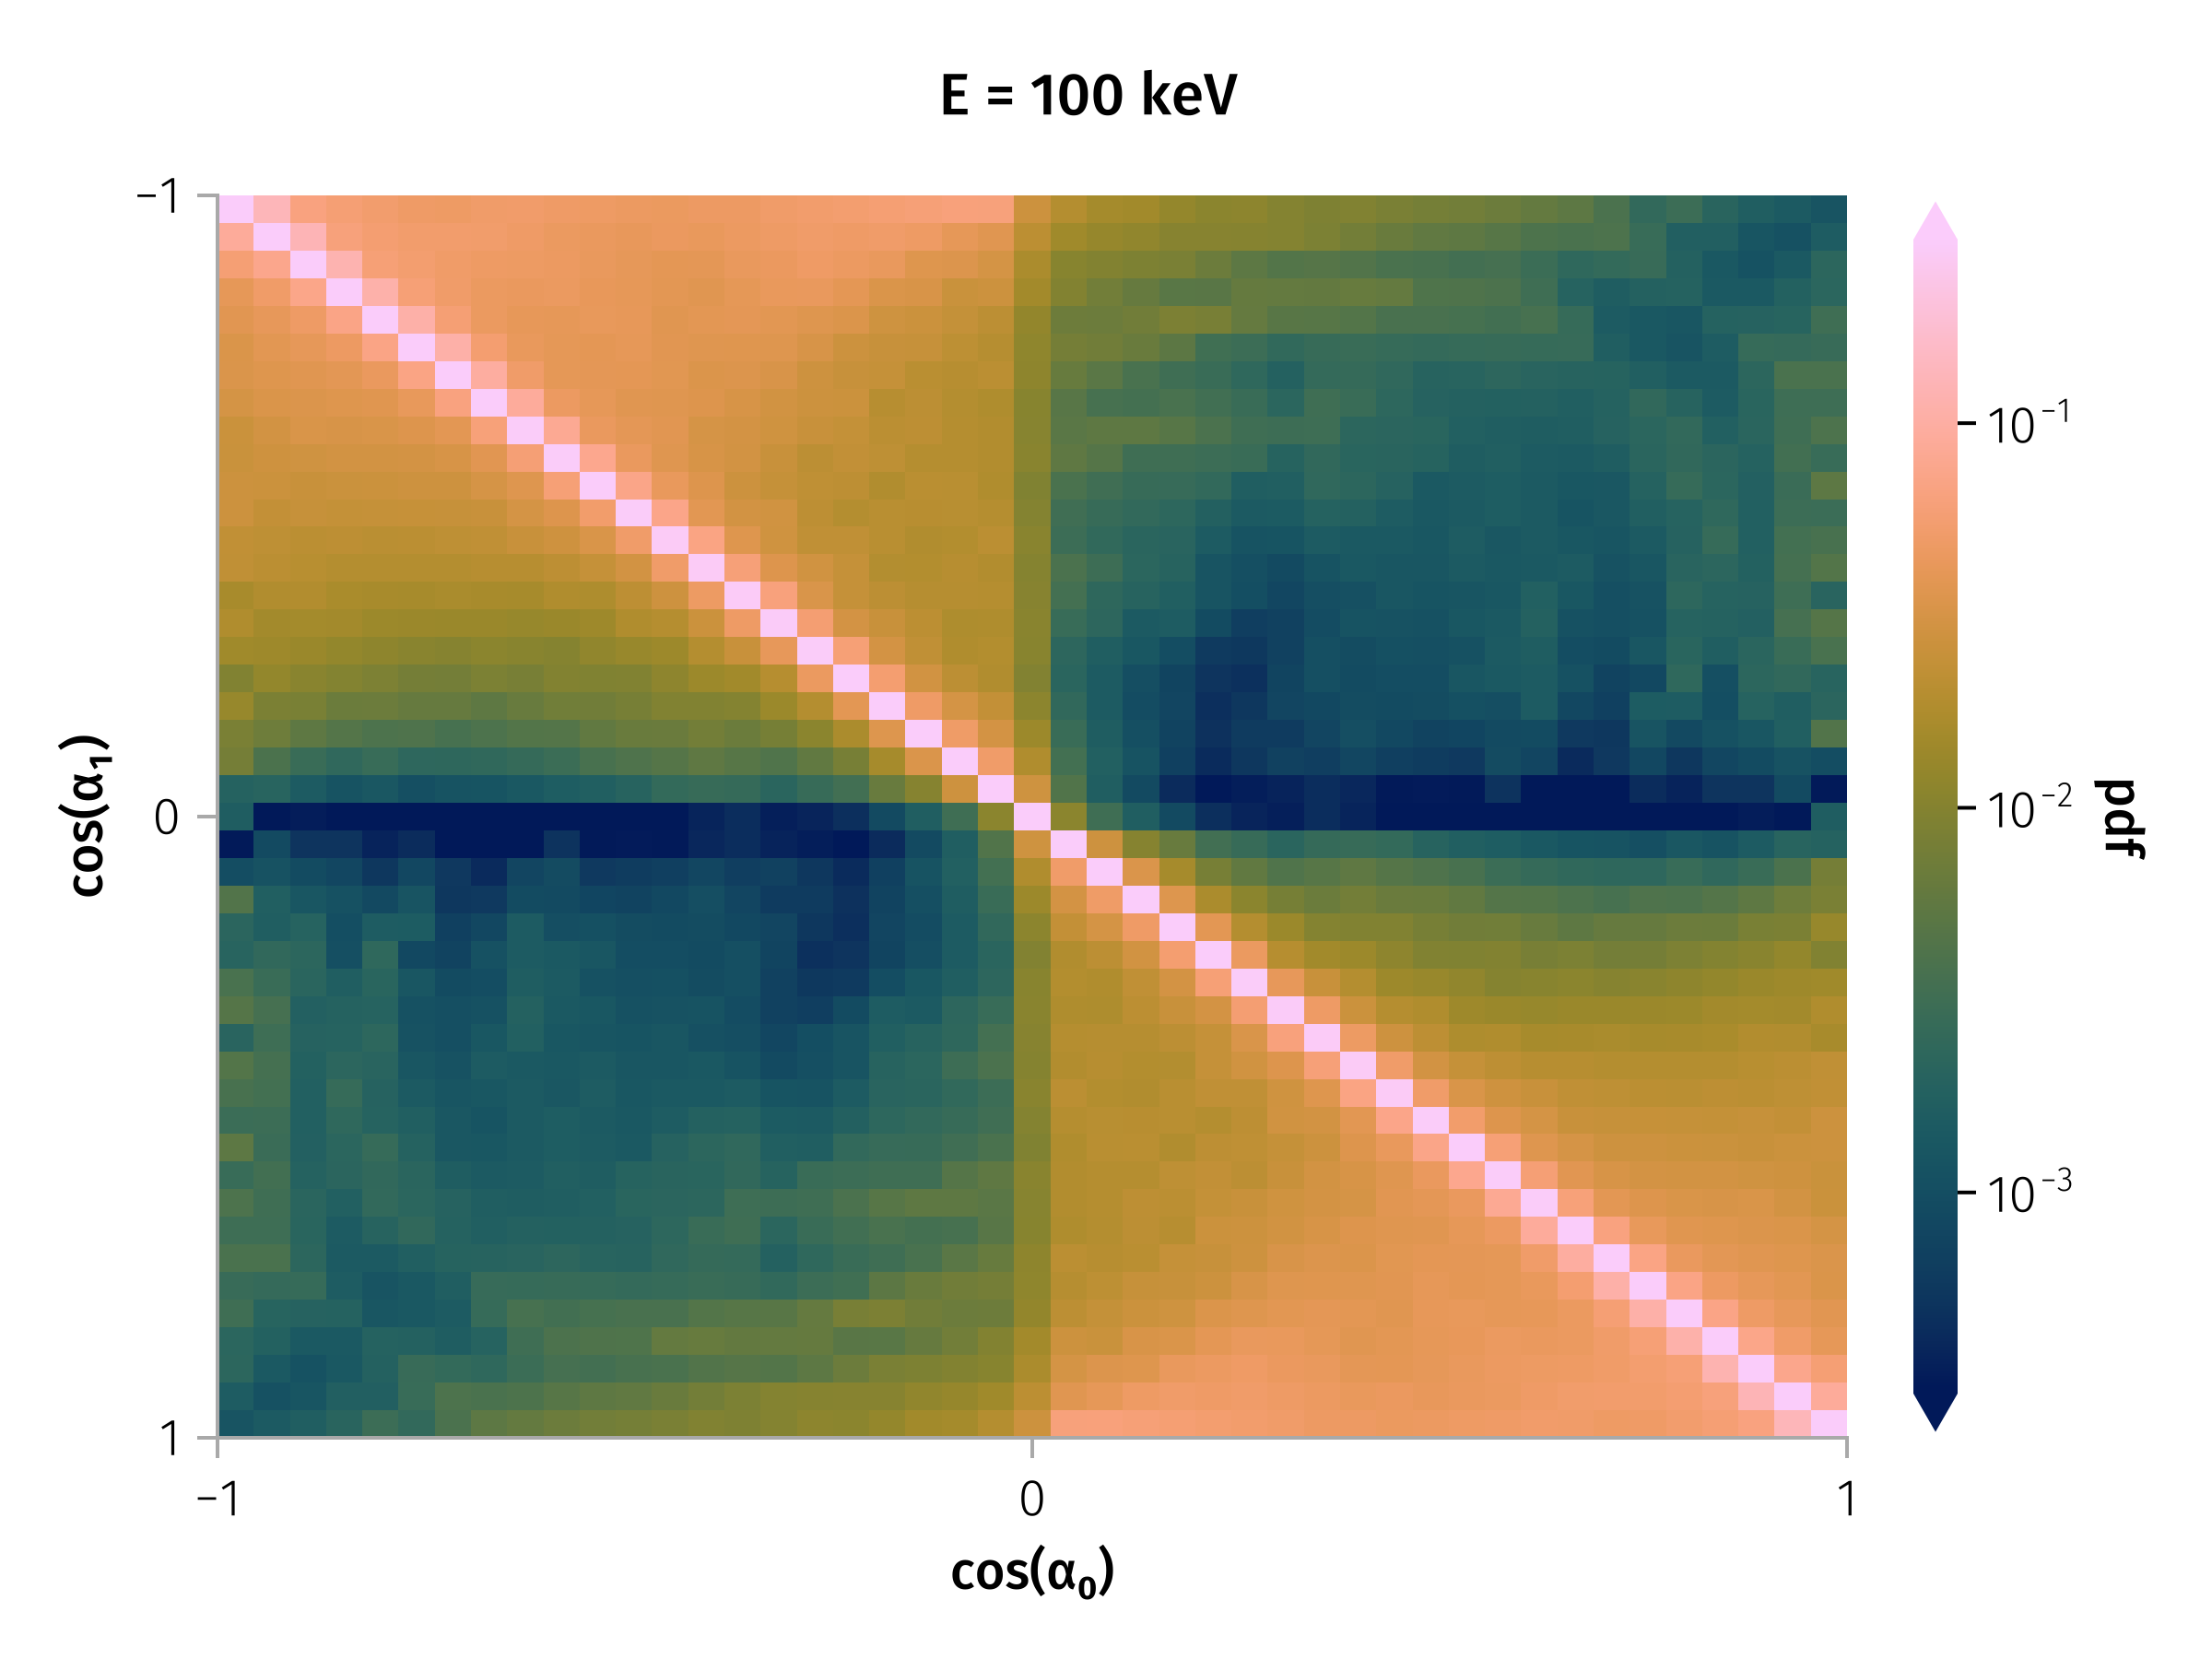

Transition Matrix
Aggregates scattering probabilities across observed current sheets.
$p\left(α_{1}|α_{0},Π\right)$ =>
$p\left(α_{1}|α_{0}\right)=\sum_{i}^{​}{p}\left(α_{1}|α_{0},Π_{i}\right)w_{i}$
Transition matrix for 100 keV protons under
four distinct magnetic field configurations
Notes:
Image: WTM heatmap from fig-tm-stats-100keV. Notes: - Aggregates scattering probabilities across observed current sheets. - Bright diagonal = most particles weakly scattered.

Slide 29
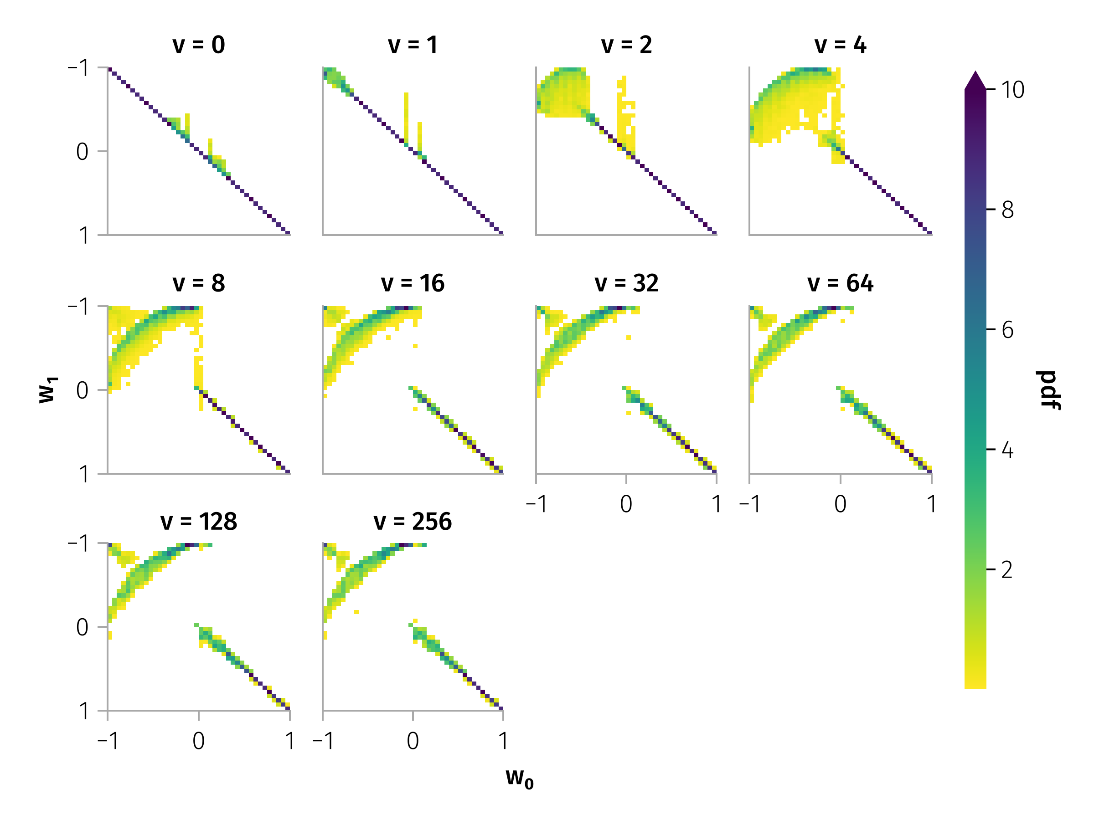
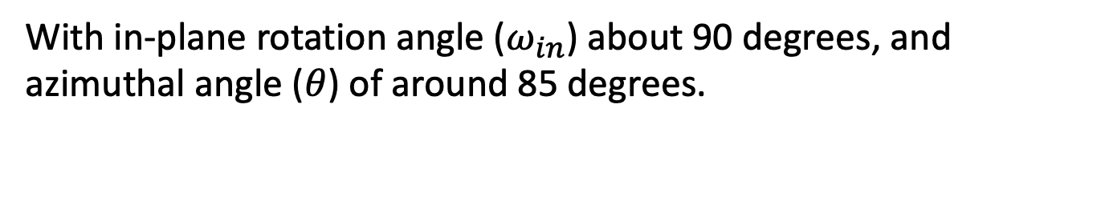
Pitch angle scattering by typical discontinuity
With in-plane rotation angle ($ω_{in}$) about 90 degrees, and azimuthal angle ($θ$) of around 85 degrees.
Luckily, higher or lower energy do not exhibit apparently different scattering probabilities.

Slide 30

Transition Matrix

Slide 31


Long-Term Pitch Angle Evolution
Example of Multiple Pitch Angle Scattering for Different Energies
$$α_{n+1,i}=W\left(α_{n,i},ξ_{n,i}\right)$$
Notes:
Notes: - Rare large-angle jumps drive rapid mixing.
A key feature of the pitch-angle dynamics is the occurrence of infrequent but substantial jumps, including rare, large-angle changes that can lead to particle reflection from the current sheet.
However, directly incorporating stochastic difference equations and the WTM into classical numerical schemes for transport-diffusion equations is a complex task. To facilitate comparison with other scattering processes and allow inclusion of SWD-induced scattering effects in such models, we evaluate the effective scattering rate, $D_{nn}$. This rate acts as a global diffusion coefficient, independent of the local pitch angle, since high-energy particles frequently experience large pitch-angle jumps, leading to strong mixing. The scattering rate depends on the particle energy and the WTM (i.e., the distribution of current sheets). Using the mapping described in Equation~\ref{eq-mapping} for an ensemble of particles, we calculate the evolution of the second moment of the pitch-angle distribution for the particle energy range from 100 keV to 1 MeV for current sheets at 1 AU:

Slide 32




Pitch angle scattering Diffusion
$$\begin{matrix}M_{1}\left(n\right)=N^{−1}\sum_{i=1}^{N}{\left(α_{n,i}−α_{0,i}\right)} \\ M_{2}\left(n\right)=N^{−1}\sum_{i=1}^{N}{{\left(α_{n,i}−α_{0,i}\right)}^{2}}−M_{1}^{2}\left(n\right)\end{matrix}$$
Notes:
Notes:
(D_{nn}) quantifies scattering efficiency.
To translate the number of interactions n into a physical time, we consider the occurrence rate of SWD [35, 50] and the average solar wind speed. Using these parameters, we can estimate the average distance between SWDs. Assuming that protons travel freely between interactions at velocities vp ∼ √H, we can then derive the characteristic time interval between consecutive encounters with discontinuities. This enables the transition from a discrete interaction-based framework (Dμμ) to a continuous temporal description (Dμμ), making it suitable for realistic modeling of particle dynamics and enabling direct incorporation of derived diffusion rates into transport-diffusion simulations. This approach provides a simplified yet effective means to account for current-sheet-induced scattering in broader models of energetic particle dynamics.

Slide 33
Part 1.5: Multifluid Model for Current Sheet Alfvénicity
Part 0: Research Context and Background
Part 1: Observational Analysis of Current Sheets
Part 2: Quantitative Modeling of Particle Scattering
Part 1.5: Multifluid Model for Current Sheet Alfvénicity
Part 0: Software Development
Part 3: Proposed Research
Conclusion
The goal of physics is to find the simplest possible description that accounts for all observations.
- Steven Weinberg

Slide 34

Question:
Why do current sheets appear increasingly non-Alfvénic with distance, despite their force-free magnetic structure?
Statistics of the asymptotic velocity ratio from PSP, Wind, and ARTEMIS spacecraft observations during PSP encounter 7.

Slide 35

Theory - previous art

Slide 36

Multi-fluid collisionless plasma model in a nutshell
The governing equations for the multi-fluid collisionless plasma model can be expressed in conservation law form as follows:
$$\left(\frac{∂}{∂t}+u_{α}·∇\right)n_{α}=−n_{α}∇·u_{α}$$
$$m_{α}n_{α}\left(\frac{∂}{∂t}+u_{α}·∇\right)u_{α}=−∇·P_{α}+q_{α}n_{α}\left(E+\frac{u_{α}×B}{c}\right)$$
$$∇×B=μ_{0}J$$
$$∇·B=0$$
where $α$ indicates the particle species…

Slide 37


Alfvénicity
$$\left(\sum_{α}^{​}{Γ_{α}}m_{α}\right)Δv_{A,x}=\sqrt{\sum_{α}^{​}{m_{α}}n_{α}\left(∞\right)\sum_{α}^{​}{\frac{m_{α}Γ_{α}^{2}}{n_{α}\left(∞\right)}}}ΔU_{x}$$
where $Γ_{α}=n_{α}u_{αz}$ is constant parameter from the conservation of fluid mass.
For a single-fluid plasma, this expression reduces to the simpler $Δv_{A,x}=ΔU_{x}$
For two counter-streaming ion fluids with $m_{1}=m_{2},u_{z,1}\left(∞\right)=−u_{z,2}\left(∞\right)$, the above expression can be further simplified to:
$$\left|n_{1}\left(∞\right)−n_{2}\left(∞\right)\right|Δv_{A,x}=\left(n_{1}\left(∞\right)+n_{2}\left(∞\right)\right)ΔU_{x}$$

Slide 38






Detailed profile within current sheet
$n_{1}=1.5n_{2}$ and $L=d_{i},B_{0}=2B_{z}$
Ion bulk velocity in the $x$ direction $U_{x}$ profiles normalized by local Alfvén velocity $v_{A,x}\left(z\right)=B_{x}\left(z\right)/\sqrt{μ_{0}m_{p}n\left(z\right)}$ for different $n_{1}\left(∞\right)$
Notes:
Here, $z$ is the distance from the center of the 1-D current sheet, $n_{α}$ denotes the number density of ion species $α$, $d_{i}$ is the asymptotic ion inertial length, and $B_{0}$ is the in-plane magnetic field strength

Slide 39
Part 0: Software Development
Part 0: Research Context and Background
Part 1: Observational Analysis of Current Sheets
Part 2: Quantitative Modeling of Particle Scattering
Part 1.5: Multifluid Model for Current Sheet Alfvénicity
Part 0.5: Software Development
Part 3: Proposed Research
Conclusion
Programming is not about typing, it’s about thinking.
- Rich Hickey

Slide 40


ChargedParticles.jl
Representing charged particles with type (memory-efficient, ready to use in test particle / PIC simulations).
julia> p = particle("Fe") julia> p.element
PlasmaFormulary.jl:
Calculation done performantly, flexibly and right. <=> plasmapy.formulary
julia> gyrofrequency(0.01u"T", :e) ≈ gyrofrequency("electron", 1e7u"nT")
1.7588200107721632e9 rad s⁻¹

Slide 41
SPASE metadata model HAPI specification
SpaceDataModel.jl:
Data model for handling space/heliospheric science data
name = "Magnetospheric Multiscale" [metadata] abbreviation = "MMS" [instruments.fpi] name = "Fast Plasma Investigation" datasets = ["fpi_moms"] [datasets.fpi_moms] format = "MMS{probe}_FPI_{data_rate}_L2_{data_type}-MOMS" ...
[datasets.fpi_moms.metadata] probes = [1, 2, 3, 4] data_rates = ["fast", "brst"] data_types = ["des", "dis"] [datasets.fpi_moms.parameters] numberdensity = "mms{probe}_{data_type}_numberdensity_{data_rate}" bulkv_gse = "mms{probe}_{data_type}_bulkv_gse_{data_rate}" temppara = "mms{probe}_{data_type}_temppara_{data_rate}" tempperp = "mms{probe}_{data_type}_tempperp_{data_rate}" energyspectr_omni = "mms{probe}_{data_type}_energyspectr_omni_{data_rate}"

Slide 42

Speasy.jl: get data from main Space Physics WebServices.
PySPEDAS.jl: A Julia wrapper around PySPEDAS.
HAPIClient.jl: A Julia client for the Heliophysics Application Programmer’s Interface (HAPI).
using SPEDAS, HAPIClient, Speasy tplot(
"CDAWeb/AC_H0_MFI/Magnitude,BGSEc",
"2001-1-2", "2001-1-2T12”
)
Get data using Heliophysics Application Programmer’s Interface (HAPI)

Slide 43

Speasy.jl: get data from main Space Physics WebServices.
PySPEDAS.jl: A Julia wrapper around PySPEDAS.
HAPIClient.jl: A Julia client for the Heliophysics Application Programmer’s Interface (HAPI).
using SPEDAS, Speasy
n = DataSet("Density", [ SpeasyProduct("PSP_SWP_SPI_SF00_L3_MOM/DENS"), Base.Fix2(*, u"cm^-3") ∘ SpeasyProduct("PSP_SWP_SPC_L3I/np_moment"), SpeasyProduct("PSP_FLD_L3_RFS_LFR_QTN/N_elec"), SpeasyProduct("PSP_FLD_L3_SQTN_RFS_V1V2/electron_density") ] ) tplot(n, "2021-08-09T06", "2021-08-10T18")
Get data using Speasy.jl

Slide 44



SPEDAS.jl : Julia-based Space Physics Environment Data Analysis Software framework.
Azimuthal field line visualization

Slide 45
Part 3: Proposed Research
Part 0: Research Context and Background
Part 1: Observational Analysis of Current Sheets
Part 2: Quantitative Modeling of Particle Scattering
Part 1.5: Multifluid Model for Current Sheet Alfvénicity
Part 0.5: Software Development
Part 3: Proposed Research
Conclusion
“ But still try, for who knows what is possible? ”
- Michael Faraday

Slide 46


Parallel and perpendicular spatial diffusion coefficient
The total time between two consecutive current sheet encounters is modeled as the sum of the time spent inside the current sheet $T_{cs}$, and the time spent free-streaming between sheets $T_{fs}$:
$$T=T_{cs}+T_{fs}, T_{fs}=\frac{s_{fs}}{\left|v_{∥,1}\right|}$$
In the absence of scattering, the particle would follow the field line and travel a distance:
$$s_{0}=\left|v_{∥,0}\right|⋅T=\left|v_{∥,0}\right|\left(T_{cs}+\frac{s_{fs}}{\left|v_{∥,1}\right|}\right).$$
However, when scattering occurs, the total distance traveled becomes:
$$s=s_{cs}^{∗}+\text{sign}\left(\frac{v_{∥,1}}{v_{∥,0}}\right)s_{fs}≈\text{sign}\left(\frac{v_{∥,1}}{v_{∥,0}}\right)s_{fs}$$
The net displacement compared to the unperturbed case is then:
$$Δs_{∥}=s−s_{0}=s_{fs}\left(\text{sign}\left(\frac{v_{∥,1}}{v_{∥,0}}\right)−\frac{\left|v_{∥,0}\right|}{\left|v_{∥,1}\right|}\right)−\left|v_{∥,0}\right|T_{cs}$$
The parallel spatial diffusion coefficient is then expressed as:
$$κ_{∥}=\frac{{\left(Δs_{∥}\right)}^{2}}{Δt}$$
Similarly, for the perpendicular direction:
$$κ_{⟂}=\frac{{\left(Δs_{⟂}\right)}^{2}}{T_{cs}+\left|s_{fs}/v_{∥,1}\right|}.$$
Example trajectory of a particle interacting with a current sheet

Slide 47
Timeline
Months 1–4:
Refine the pitch-angle scattering model to incorporate both parallel and perpendicular spatial diffusion effects
Conduct detailed test-particle simulations using solar wind parameters derived from multi-spacecraft observations
Months 5–7:
Identify observational signatures;
Examine how current sheet properties influence SEP scattering across different heliocentric distances.
Months 8–10:
Finalize the spatial diffusion model and assess its implications for large-scale SEP propagation
“
Still round the corner there may wait.
A new road or a secret gate.
”
- J. R. R. Tolkien

Slide 48
Opportunities for Future Research
Completion of this thesis opens several avenues for future investigations:
Exploration of current sheet interactions in other astrophysical environments, such as planetary magnetospheres.
Advanced integration of mapping techniques with numerical simulations to further refine SEP transport models.
Expanded observational campaigns utilizing upcoming spacecraft missions designed to probe heliospheric turbulence and particle dynamics at unprecedented resolution.

Slide 49
References

Slide 50

Bale, S. D., S. T. Badman, J. W. Bonnell, T. A. Bowen, D. Burgess, A. W. Case, C. A. Cattell, et al. 2019. “Highly Structured Slow Solar Wind Emerging from an Equatorial Coronal Hole.” Nature 576 (7786): 237–42. https://doi.org/10.1038/s41586-019-1818-7.
Greco, A., W. H. Matthaeus, S. Perri, K. T. Osman, S. Servidio, M. Wan, and P. Dmitruk. 2017. “Partial Variance of Increments Method in Solar Wind Observations and Plasma Simulations.” Space Science Reviews 214 (1): 1. https://doi.org/10.1007/s11214-017-0435-8.
Juneja, A., D. P. Lathrop, K. R. Sreenivasan, and G. Stolovitzky. 1994. “Synthetic Turbulence.” Physical Review E 49 (6): 5179–94. https://doi.org/10.1103/PhysRevE.49.5179.
Lario, D. 2010. “Heliospheric Energetic Particle Reservoirs: Ulysses and ACE 175-315 keV Electron Observations.” In Twelfth International Solar Wind Conference, 1216:625–28. AIP. https://doi.org/10.1063/1.3395944.
Liu, Y. Y., H. S. Fu, J. B. Cao, C. M. Liu, Z. Wang, Z. Z. Guo, Y. Xu, S. D. Bale, and J. C. Kasper. 2021. “Characteristics of Interplanetary Discontinuities in the Inner Heliosphere Revealed by Parker Solar Probe.” Astrophysical Journal 916 (2): 65. https://doi.org/10.3847/1538-4357/ac06a1.
Lotekar, A. B., I. Y. Vasko, T. Phan, S. D. Bale, T. A. Bowen, J. Halekas, A. V. Artemyev, Yu V. Khotyaintsev, and F. S. Mozer. 2022. “Kinetic-Scale Current Sheets in Near-Sun Solar Wind: Properties, Scale-dependent Features and Reconnection Onset.” The Astrophysical Journal 929 (1): 58. https://doi.org/10.3847/1538-4357/ac5bd9.
Malara, Francesco, S. Perri, J. Giacalone, and G. Zimbardo. 2023. “Energetic Particle Dynamics in a Simplified Model of a Solar Wind Magnetic Switchback.” Astronomy & Astrophysics 677 (September): A69. https://doi.org/10.1051/0004-6361/202346990.
Meneveau, C., and K. R. Sreenivasan. 1987. “Simple Multifractal Cascade Model for Fully Developed Turbulence.” Physical Review Letters 59 (13): 1424–27. https://doi.org/10.1103/PhysRevLett.59.1424.
Parker, E. N. 1965. “The Passage of Energetic Charged Particles Through Interplanetary Space.” Planetary and Space Science 13 (1): 9–49. https://doi.org/10.1016/0032-0633(65)90131-5.
Perri, S., and G. Zimbardo. 2007. “Evidence of Superdiffusive Transport of Electrons Accelerated at Interplanetary Shocks.” Astrophysical Journal 671 (December): L177–80. https://doi.org/10.1086/525523.
Pucci, F., F. Malara, S. Perri, G. Zimbardo, L. Sorriso-Valvo, and F. Valentini. 2016. “Energetic Particle Transport in the Presence of Magnetic Turbulence: Influence of Spectral Extension and Intermittency.” Monthly Notices of the Royal Astronomical Society 459 (3): 3395–3406. https://doi.org/10.1093/mnras/stw877.
Reames, Donald V. 2013. “The Two Sources of Solar Energetic Particles.” Space Science Reviews 175 (1): 53–92. https://doi.org/10.1007/s11214-013-9958-9.
Söding, A., F. M. Neubauer, B. T. Tsurutani, N. F. Ness, and R. P. Lepping. 2001. “Radial and Latitudinal Dependencies of Discontinuities in the Solar Wind Between 0.3 and 19 AU and -80$​^{∘}$ and +10$​^{∘}$.” Annales Geophysicae 19 (7): 667–80. https://doi.org/10.5194/angeo-19-667-2001.
Tan, Lun C. 2023. “Turbulent Origins of Particle Intensity Dropout in Gradual Solar Energetic Particle Events During Solar Cycle 23.” Astrophysical Journal 954 (1): 26. https://doi.org/10.3847/1538-4357/ace1f2.
Vasko, I. Y., K. Alimov, T. D. Phan, F. S. Mozer, and A. V. Artemyev. 2024. “Kinetic-Scale Current Sheets in the Solar Wind at 5 AU.” Journal of Geophysical Research: Space Physics 129 (6): e2024JA032586. https://doi.org/10.1029/2024JA032586.
Vasko, I. Y., K. Alimov, T. Phan, S. D. Bale, F. S. Mozer, and A. V. Artemyev. 2022. “Kinetic-Scale Current Sheets in the Solar Wind at 1 Au: Scale-Dependent Properties and Critical Current Density.” Astrophysical Journal Letters 926 (2): L19. https://doi.org/10.3847/2041-8213/ac4fc4.

